Slide 1
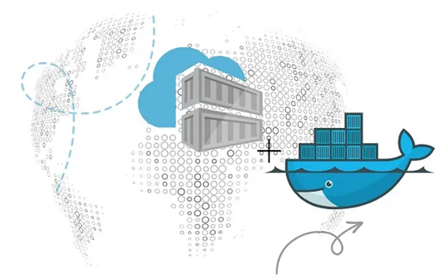
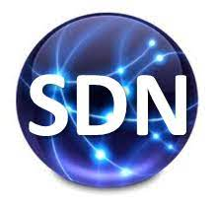
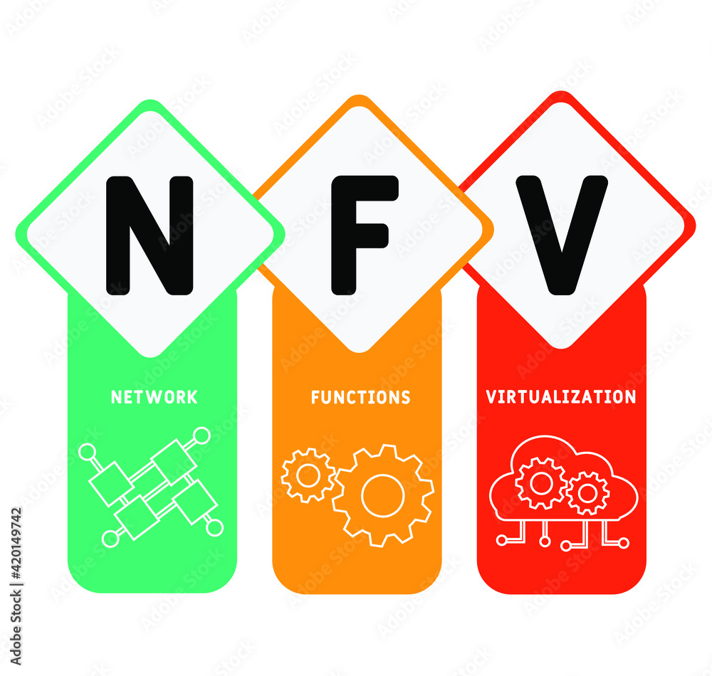
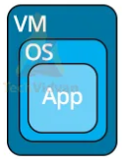
PDS
Computer Vision
Deploying a Node App to Google Cloud with Kubernetes
.
https://github.com/siagianp
https://www.youtube.com/@AmelOline/videos
https://github.com/amelcharolinesgn2/IoT_simulator-mqtt-NodeRed
https://github.com/amelcharolinesgn2/Cloud-Infrastructures
Notes:
https://www.netapp.com/learn/cvo-blg-how-to-build-a-multicloud-kubernetes-cluster-in-aws-and-azure/

Slide 2
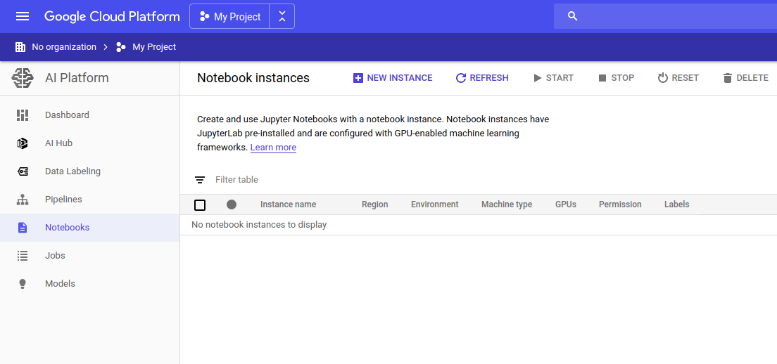
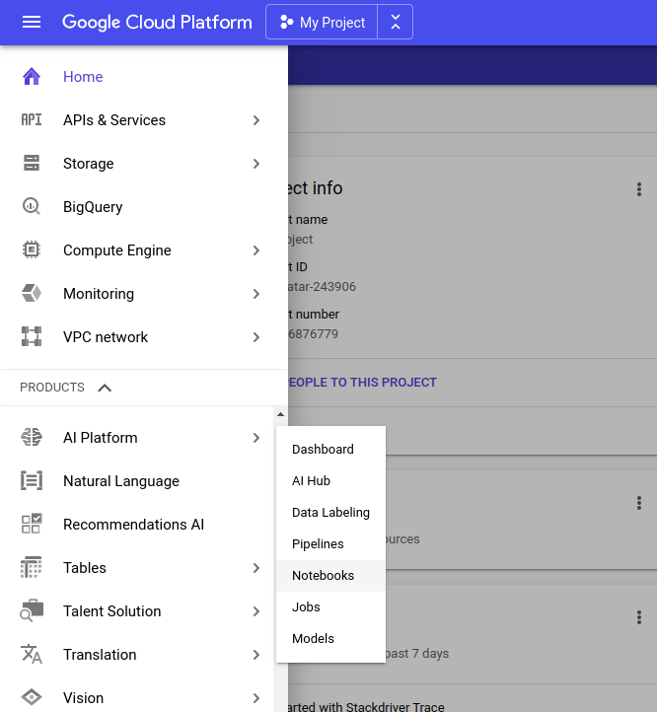
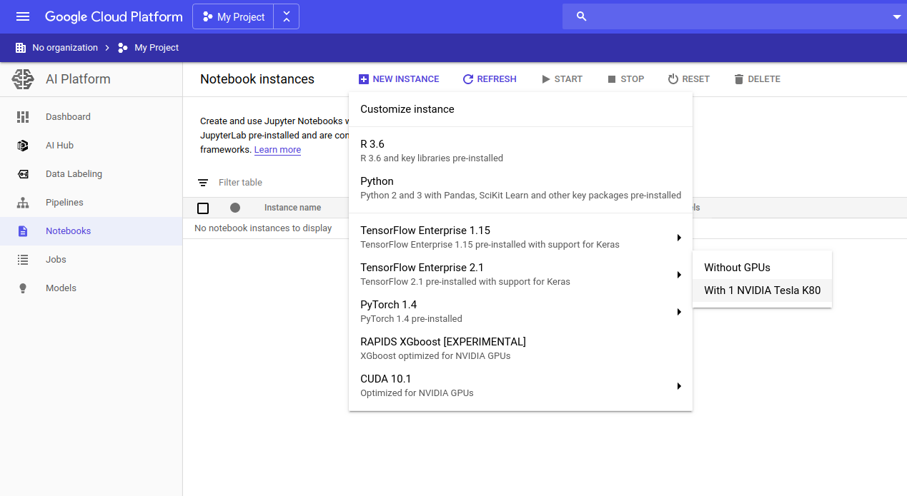
Google Cloud Platform (GCP) (Cont’s)
Google Cloud Platform (GCP)
TensorFlow, Colab
This will take you to Notebook Instances:
Click on NEW INSTANCE and select an image you want to use. Being a Google fanboy, I choose the latest TensorFlow image available.
Create Add GCP
I’ll assume that you’re logged into your GCP accounts.
In your menu, go to AI Platform -> Notebooks:
yes. I can hear you. I also asked myself the same question:
"What do I do if I want to use 8x NVIDIA Tesla V100s running on a VM with 96 vCPUs?“
If you’re willing to pay for these, you’ll be able to get them by clicking on CUSTOMIZE. If you instead accept the defaults, don’t you worry. This process will create a fully-fledged Compute Engine VM that you’ll be able to easily modify later.
Before we move on, tick Install NVIDIA GPU driver automatically for me. This takes care of our GPU setup!
Some of these images are built for deep learning. If you want to use GPUs to train your networks, choose With 1 NVIDIA Telsa K80..
Notes:
https://towardsdatascience.com/get-deep-learning-on-google-cloud-platform-the-easy-way-53f74bab5ee9/

Slide 3
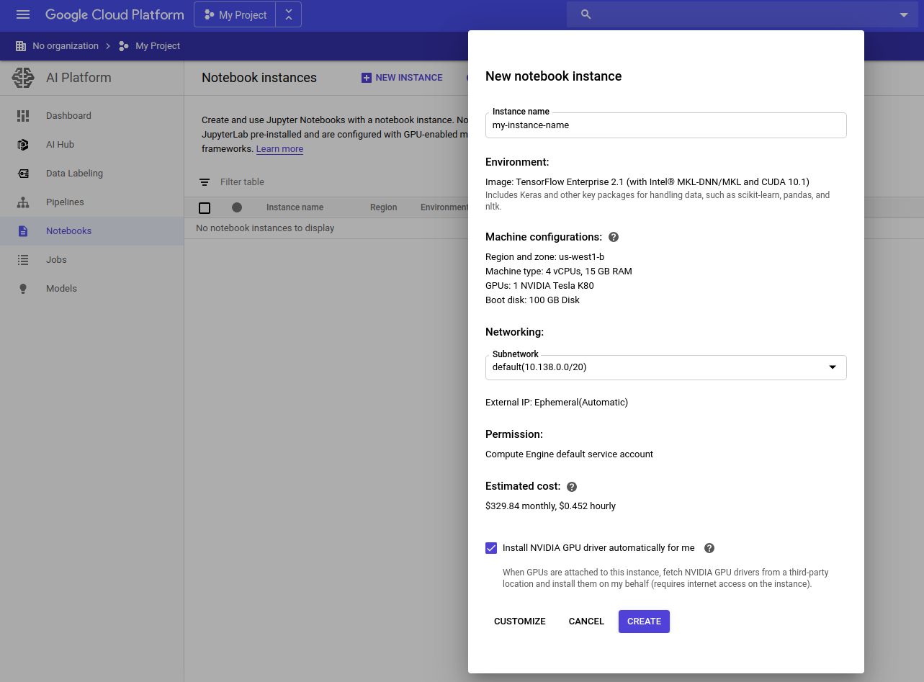
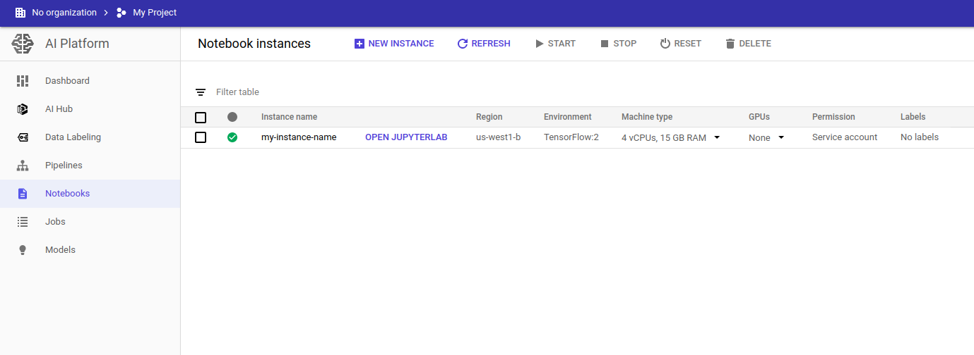
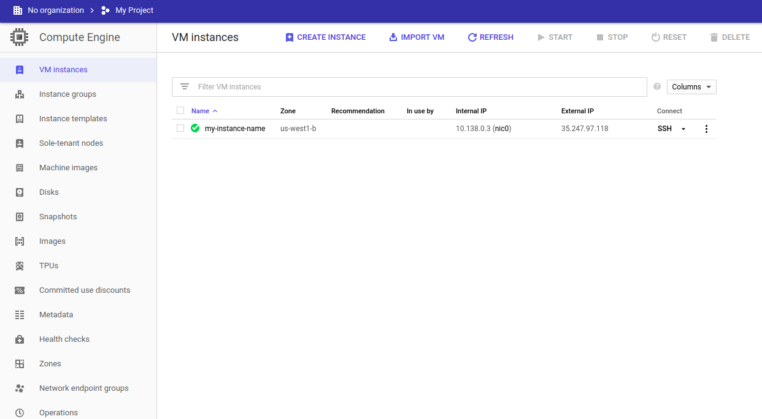
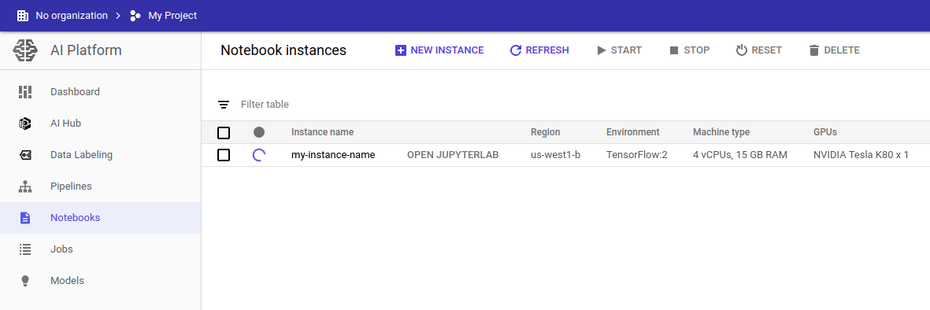
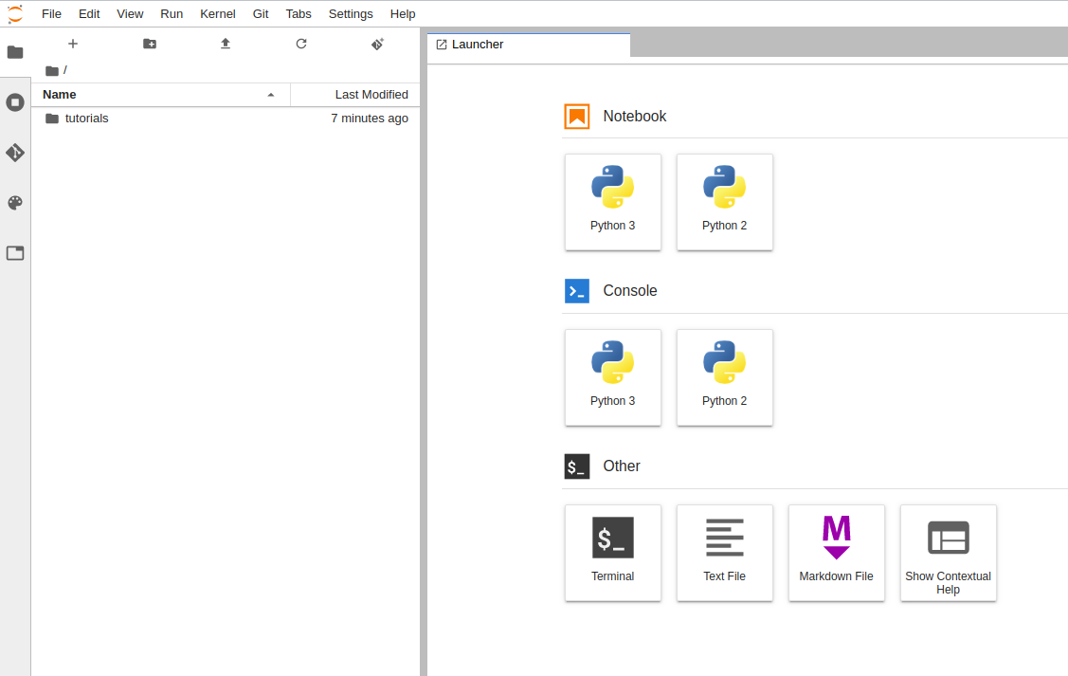
Google Cloud Platform (GCP) (Cont’s)
Google Cloud Platform (GCP)
Now smash that CREATE button
Once you see a green tick, click on OPEN JUPYTERLAB.
What if I want to further customise my VM?
This is also easy to accomplish!
Click on Compute Engine in the main menu. You’ll see your beautiful VM there.
Voila! You’re now ready to ‘learn deeply’ with a GPU in the cloud! That’s all there is to it, my friends.
Stop your VM to start editing it. Make all your usual wonderful changes like these:
Add firewall rules so that you can run TensorBoard on another port
Add extra disks
Increase the number of vCPUs, only to reduce their number later because you went mad with all the processing power at your fingertips
Doing the same with your RAM
Doing the same with your GPUs
Notes:
https://towardsdatascience.com/get-deep-learning-on-google-cloud-platform-the-easy-way-53f74bab5ee9/

Slide 4
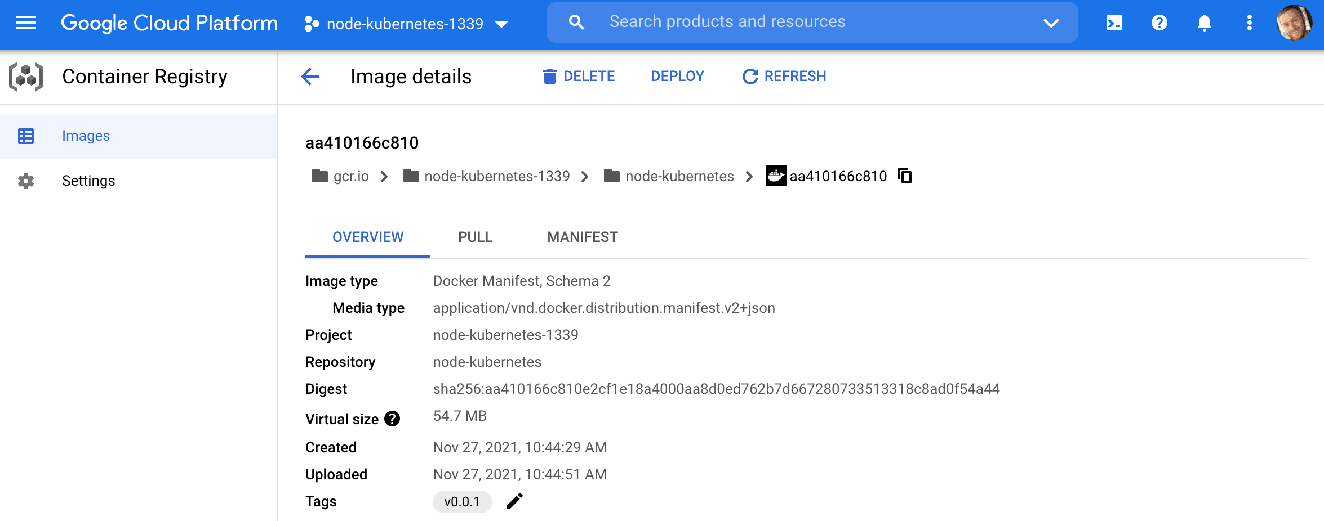
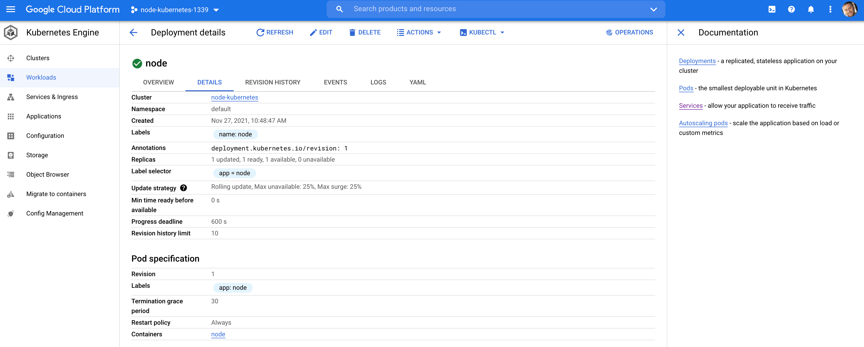
Deploying a Node App to Google Cloud with Kubernetes (Con’s)
https://github.com/testdrivenio/node-kubernetes
├── .dockerignore
├── .gitignore
├── Dockerfile
├── README.md
├── docker-compose.yml
├── knexfile.js
├── kubernetes
│ ├── node-deployment-updated.yaml
│ ├── node-deployment.yaml
│ ├── node-service.yaml
│ ├── postgres-deployment.yaml
│ ├── postgres-service.yaml
│ ├── secret.yaml
│ ├── volume-claim.yaml
│ └── volume.yaml
├── package-lock.json
├── package.json
└── src
├── db
│ ├── knex.js
│ ├── migrations
│ │ └── 20181009160908_todos.js
│ └── seeds
│ └── todos.js
└── server.js
https://testdriven.io/blog/deploying-a-node-app-to-google-cloud-with-kubernetes/

Slide 5
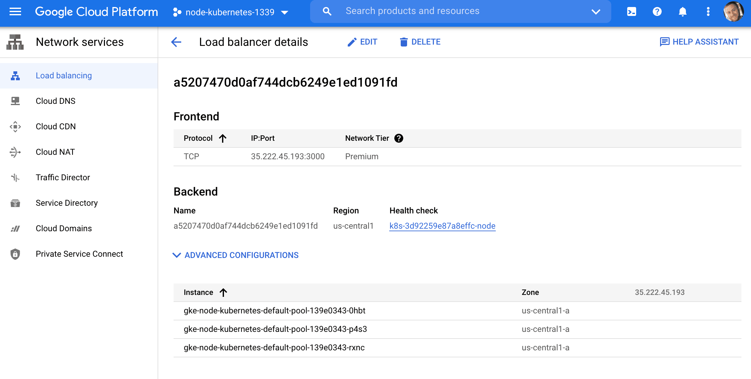
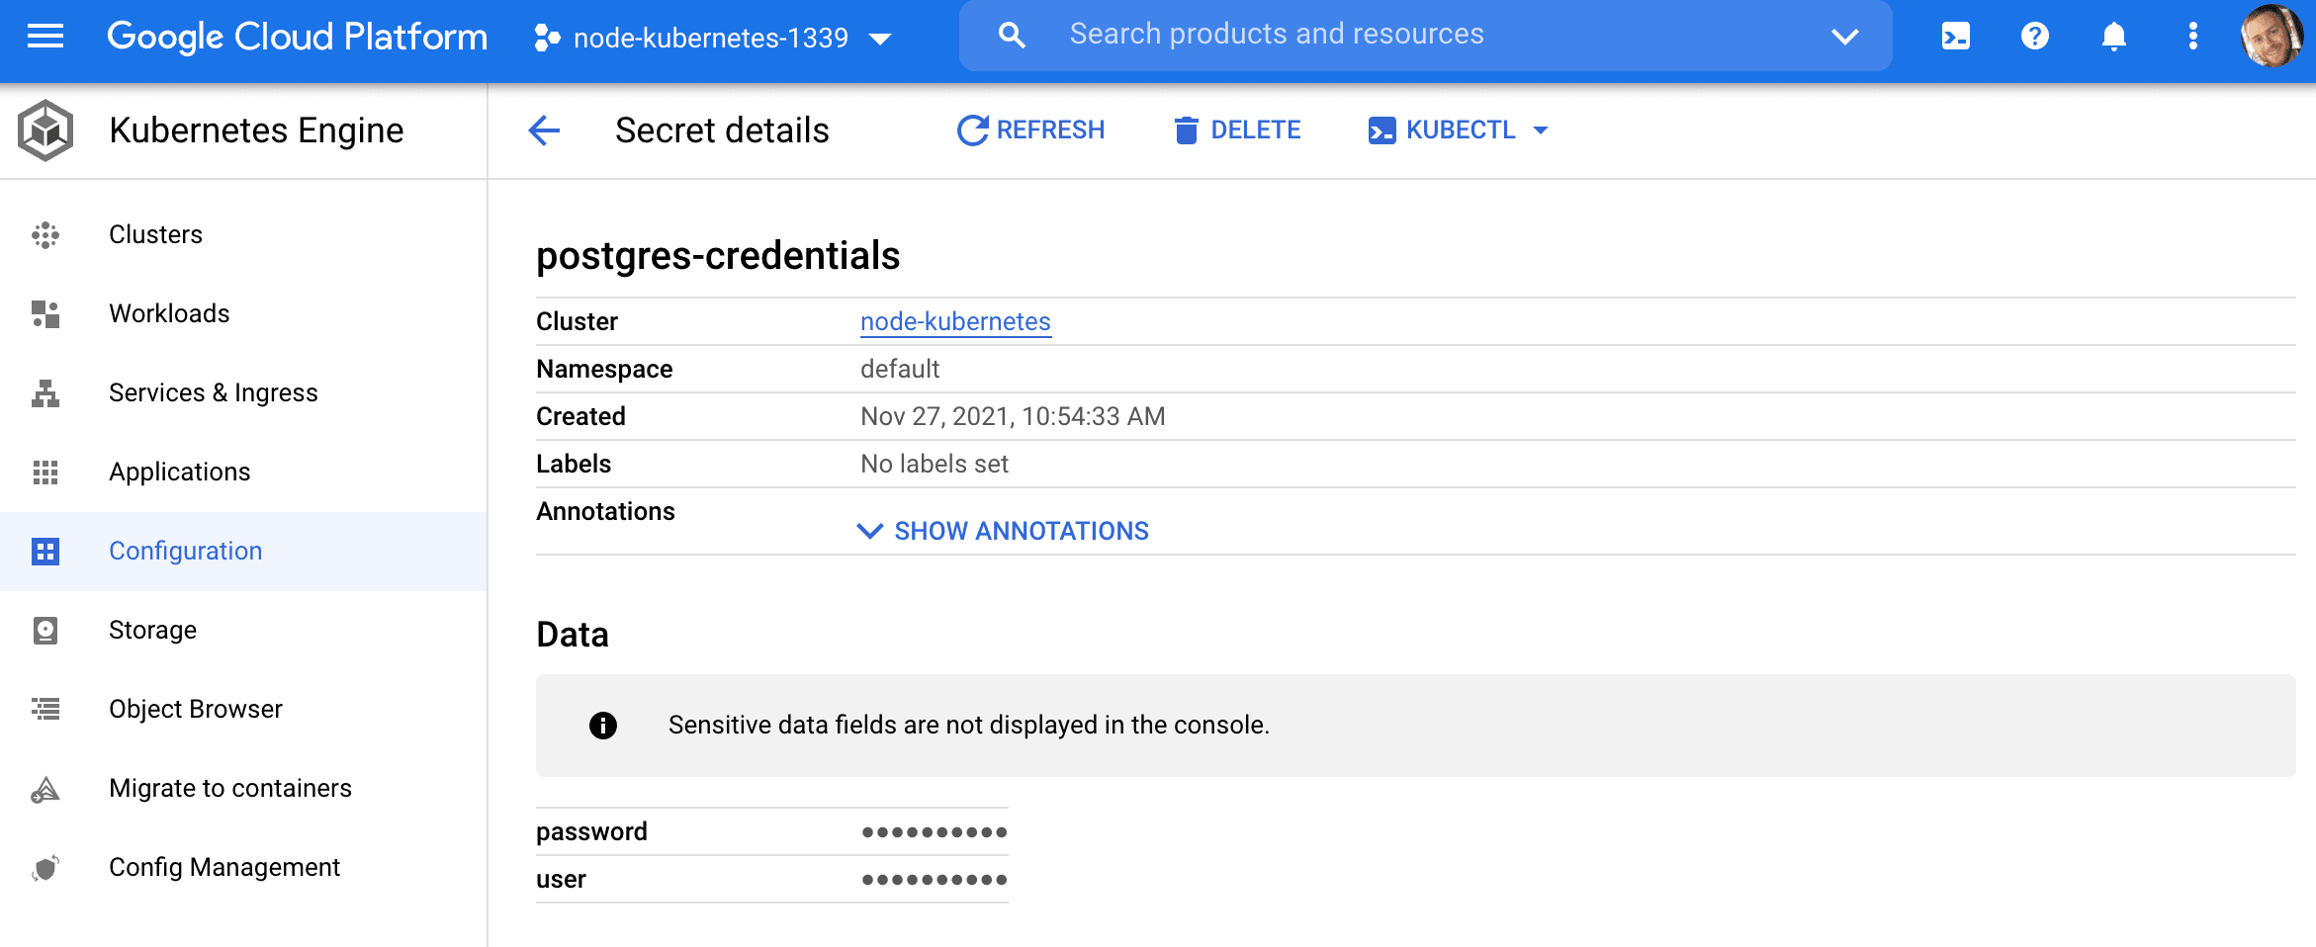
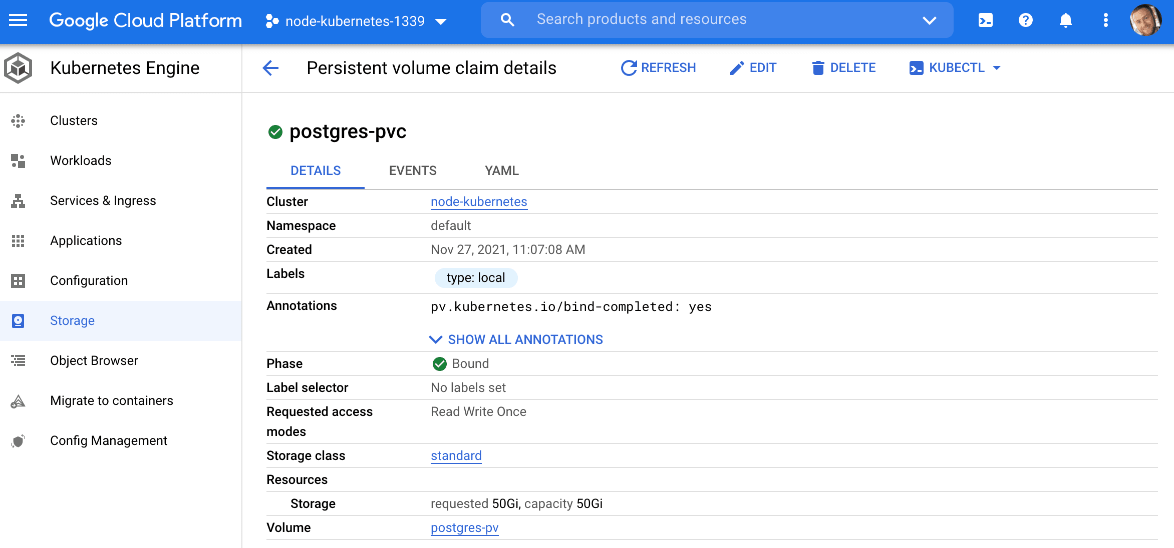
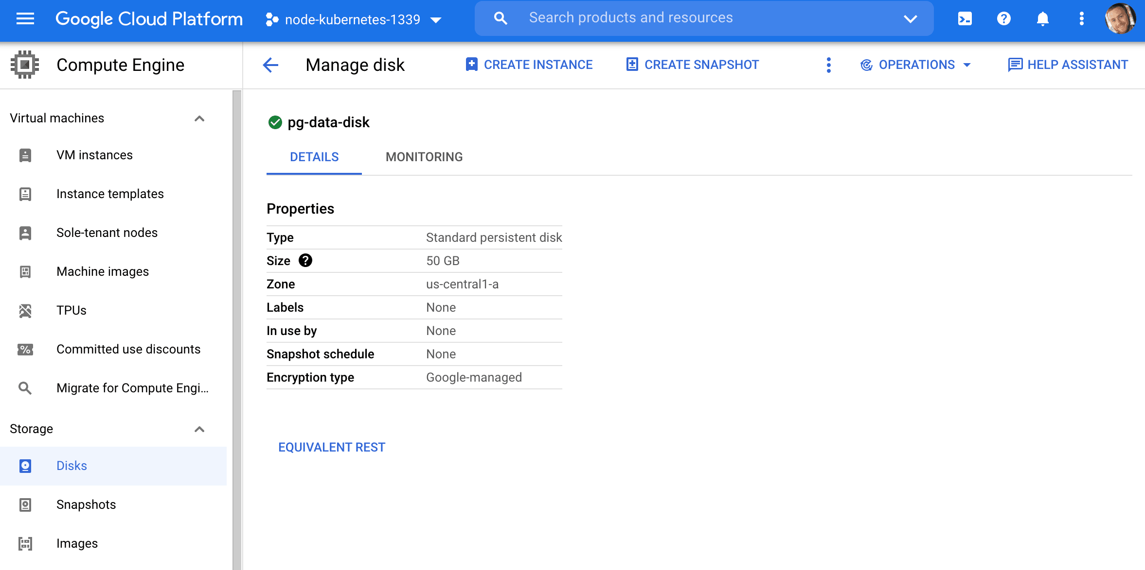
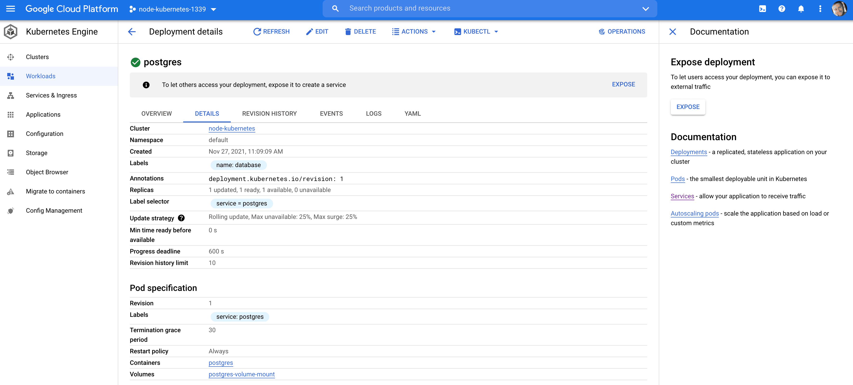
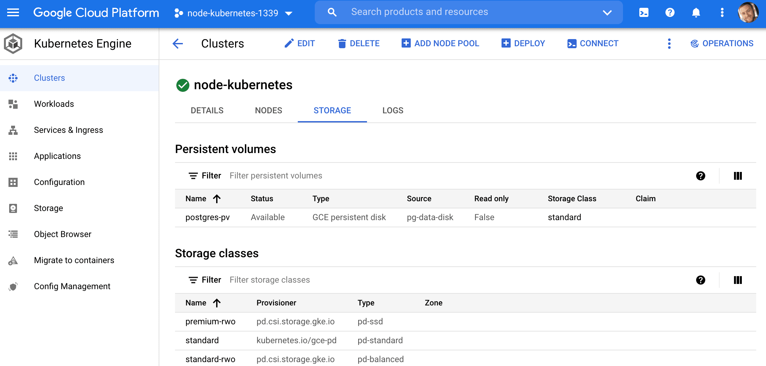
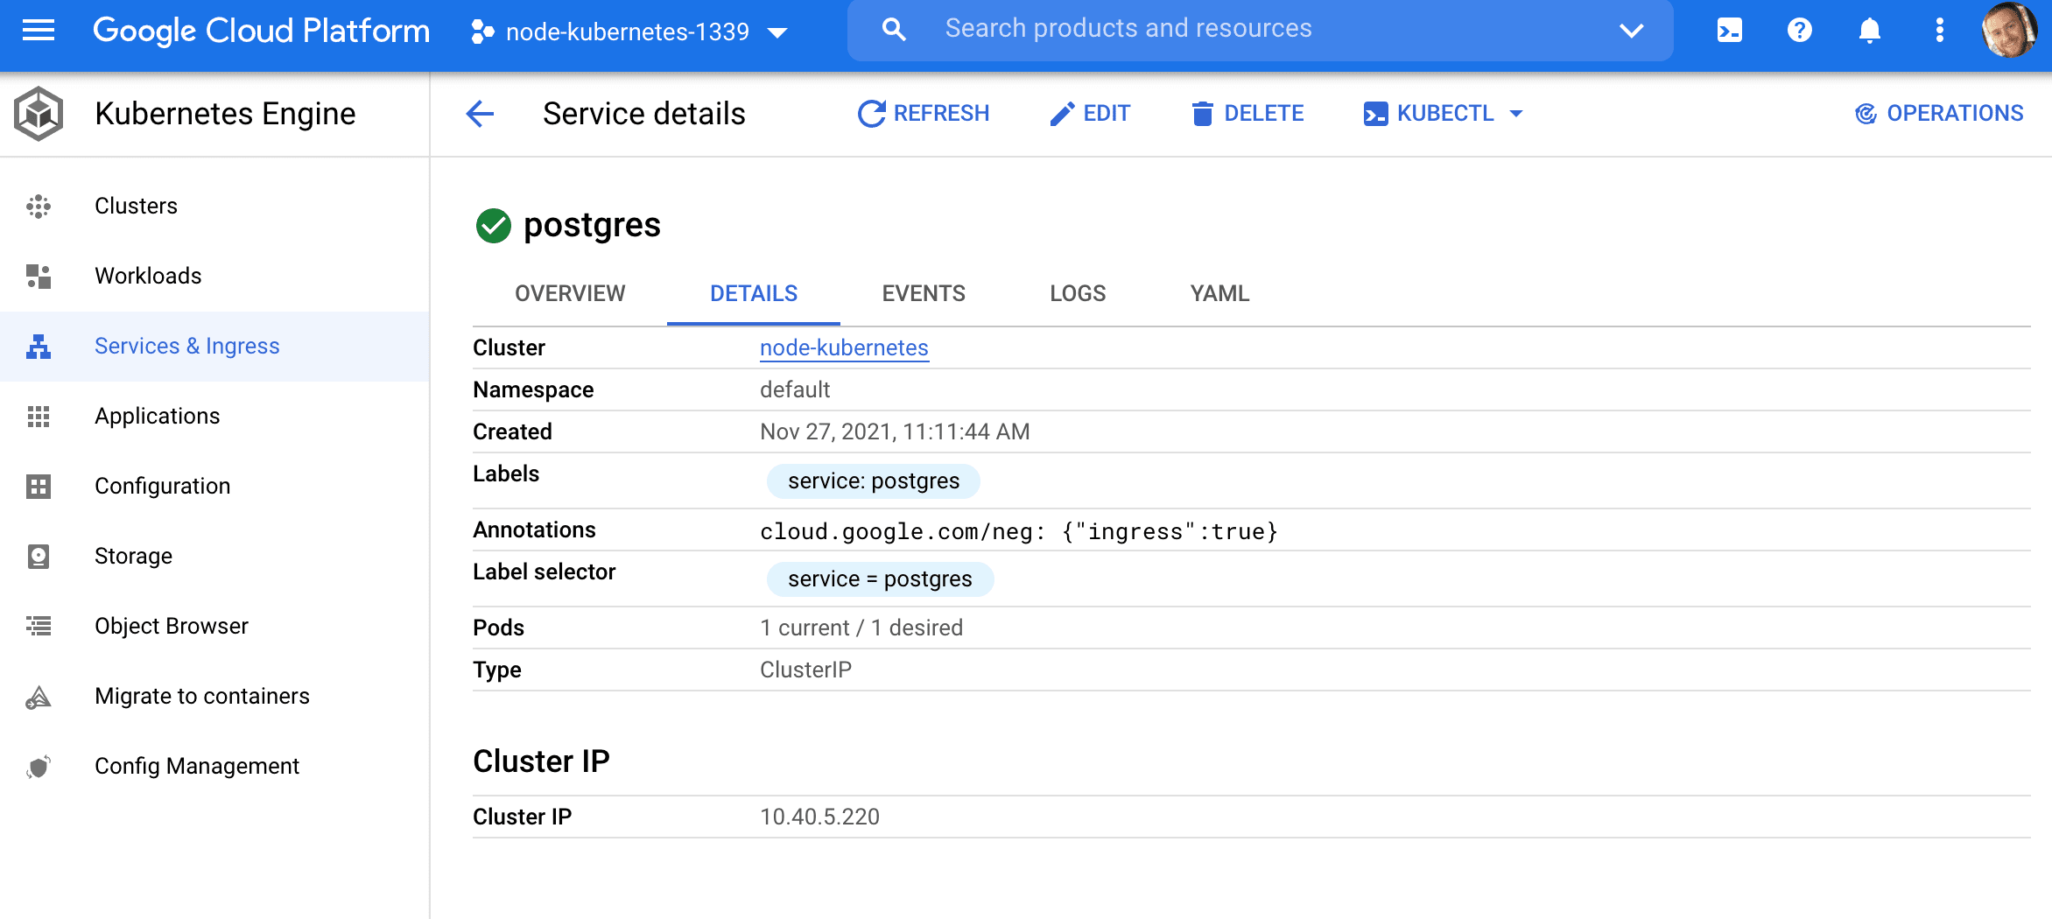
Deploying a Node App to Google Cloud with Kubernetes (Con’s)

Slide 6
Deploying a Node App to Google Cloud with Kubernetes (Con’s)

Slide 7
Github
Automate provisioning in the self-service platform
Notes:
https://conferences.oreilly.com/artificial-intelligence/ai-ny-2019/public/schedule/detail/72321.html
https://s.itho.me/events/2019/k8s/1525-1605%20%E5%BC%B5%E5%AE%B6%E6%A3%A0_AI%20on%20Kubernetes.pdf
https://medium.com/hackernoon/gpus-kubernetes-for-deep-learning-part-1-3-d8eebe0dd6fe
https://github.com/alibaba/GPU-scheduler-for-deep-learning

